Slide 1


LIFESTYLE DYNAMICS FRAMEWORK
A Data-Driven Analysis of Sleep, Stress, Physical Activity and Health Outcomes using Statistical Analysis & Machine Learning
Presented By: Aryan Dhiman

Slide 2
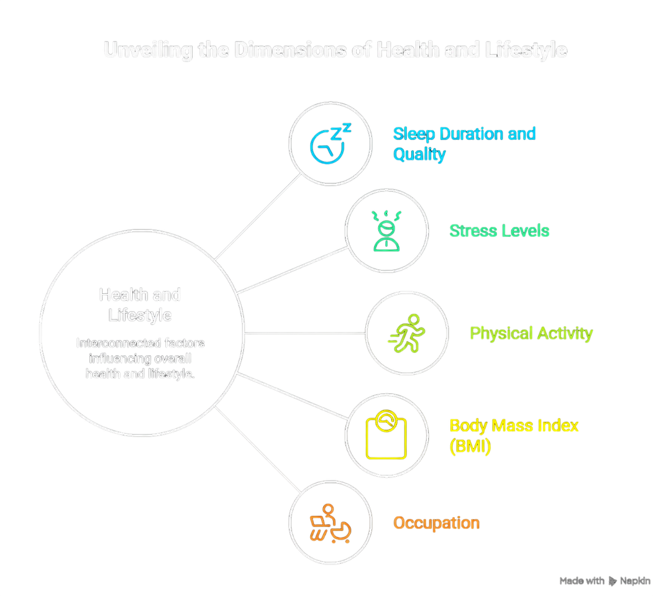
PROBLEM STATEMENT
In today's fast-paced lifestyle, factors such as:
• Sleep Duration
• Sleep Quality
• Stress Level
• Physical Activity
• BMI
• Occupation
significantly influence a person's overall health
and well-being.
Key Question:
How do sleep, stress, physical activity,
BMI and occupation influence a person's
overall lifestyle and health?

Slide 3
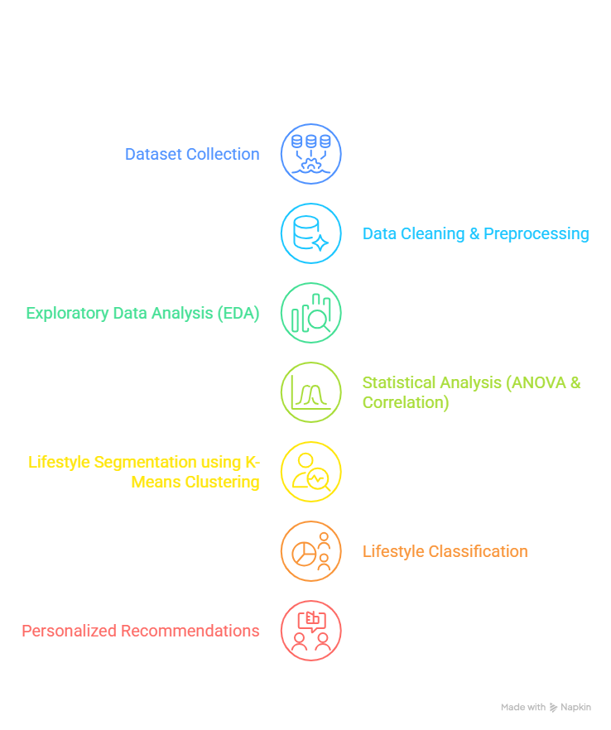
PROPOSED SOLUTION
To solve this problem, a Lifestyle Dynamics Framework was developed that:
Analyzes sleep, stress, physical activity, BMI and health data.
Identifies relationships between lifestyle factors using statistical analysis.
Uses Machine Learning (K-Means Clustering) to group individuals with similar lifestyle patterns.
Detects high-risk individuals and people with sleep disorders.
Generates personalized lifestyle recommendations.

Slide 4
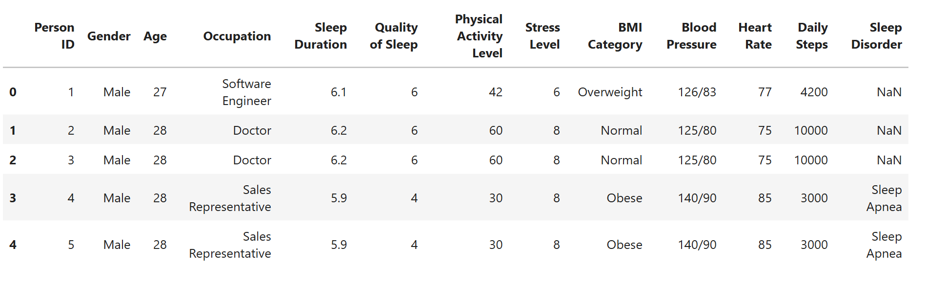
DATASET OVERVIEW
Dataset Information
Key Features
Sleep → Duration, Quality, Disorder
Health → BMI, Heart Rate, Blood Pressure
Lifestyle → Physical Activity, Daily Steps, Stress Level
Personal → Age, Gender, Occupation
📊 Dataset Name: Sleep Health and Lifestyle Dataset
👥 Total Records: 374 Individuals
📋 Total Features: 13 Columns

Slide 5
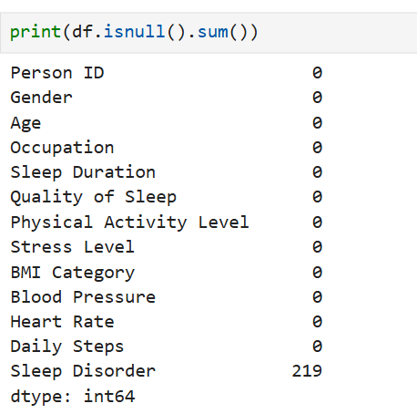
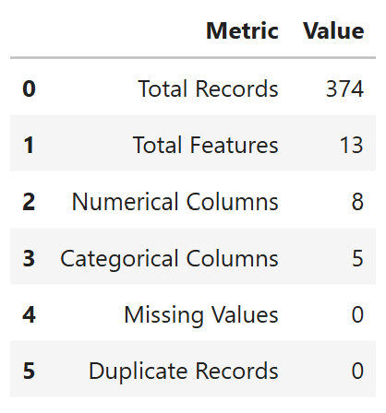
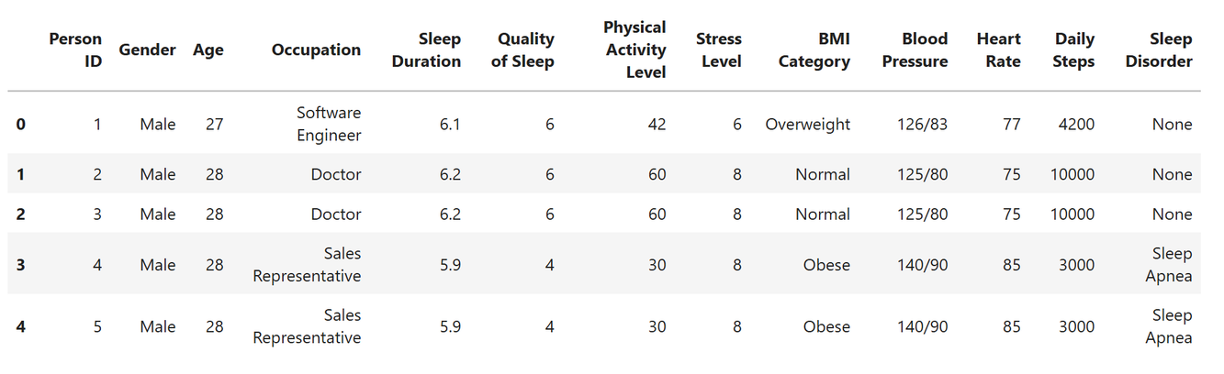
DATA CLEANING & PREPROCESSING
📂 Data Loading
Loaded 374 records and 13 features
🔍 Missing Value Check
Checked all columns for null values
Sleep Disorder column contained missing
values
🛠 Missing Value Handling
Replaced missing values in Sleep Disorder
with "None"
🔄 Duplicate Check
Verified dataset for duplicate records
No significant duplicate entries found
📊 Data Type Verification
Checked numerical and categorical features
Ensured correct data formats

Slide 6
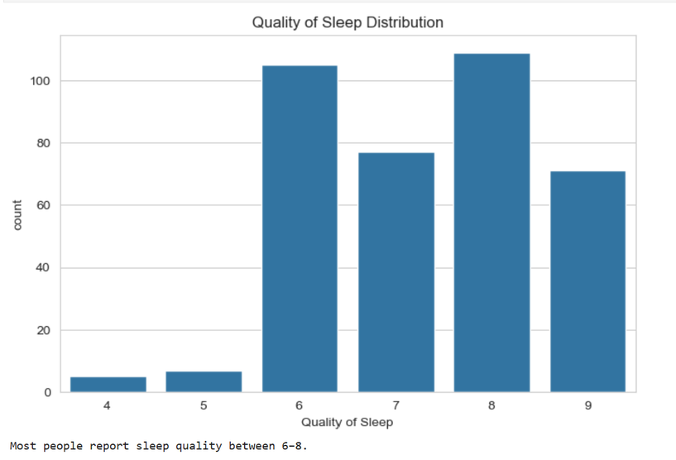
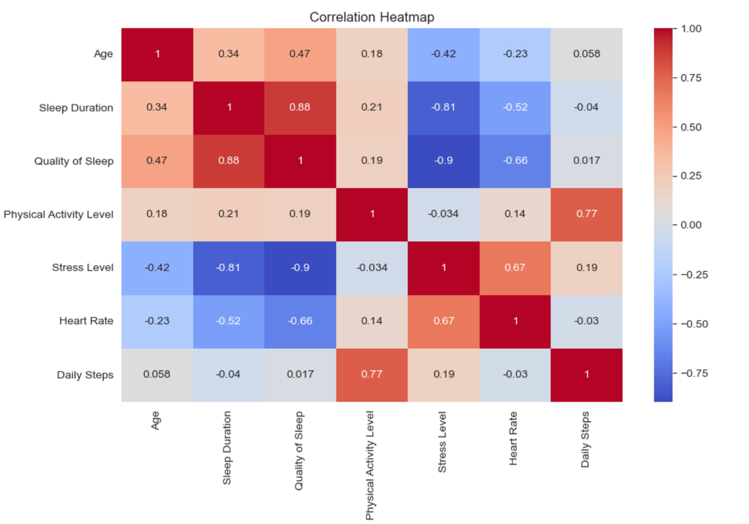
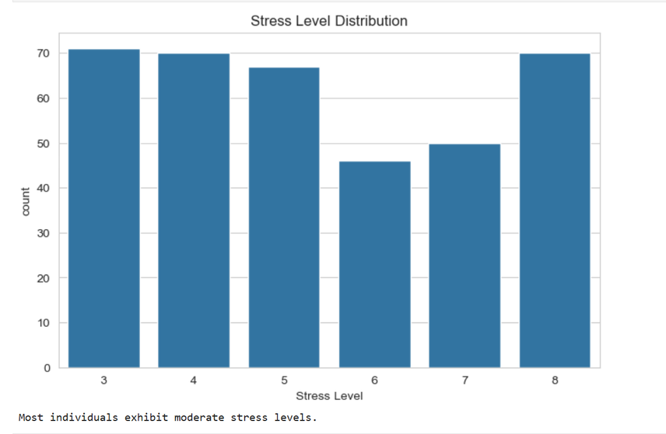
EXPLORATORY DATA ANALYSIS (EDA)
Major Insights
Sleep Quality Distribution
Stress ↑ → Sleep Quality ↓
Sleep disorders tends to poor health
Physical activity improves sleep
BMI influences sleep patterns
Stress Level Distribution

Slide 7
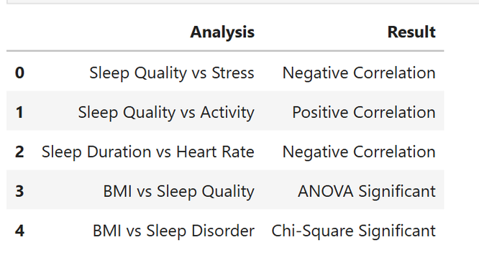
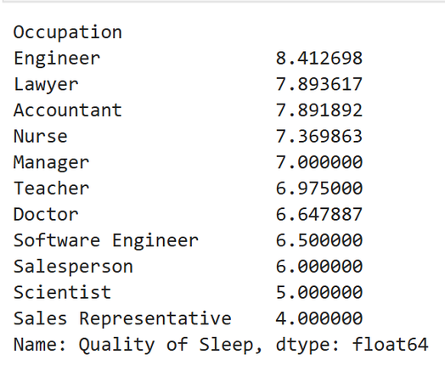
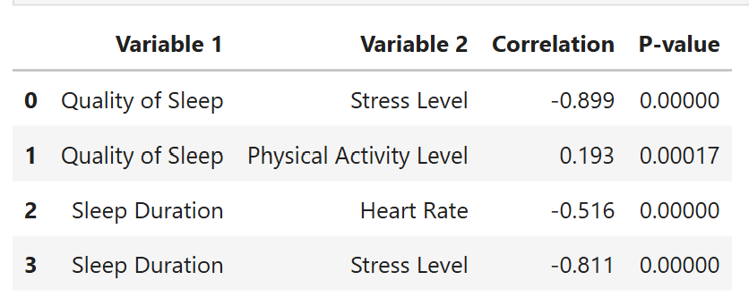
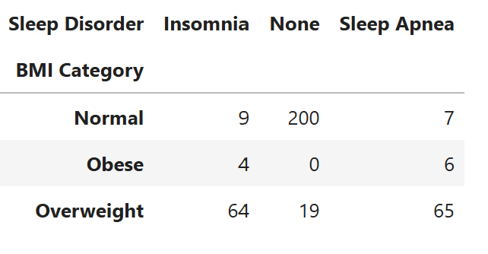
STATISTICAL ANALYSIS
Sleep Quality and Stress Level showed the strongest relationship (-0.899).
Sleep Duration is negatively associated with Stress Level (-0.811).
Physical Activity shows a weak positive relationship with Sleep Quality (+0.193)
ANOVA results indicate significant differences in sleep quality across occupations.
Overweight and obese individuals are more likely to experience sleep disorders.
Sleep health is a major indicator of overall lifestyle quality.

Slide 8
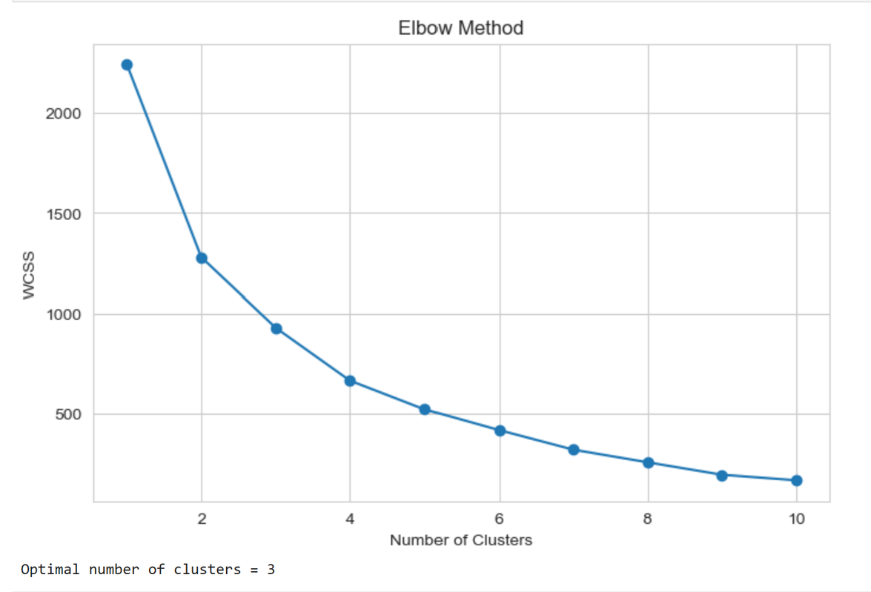
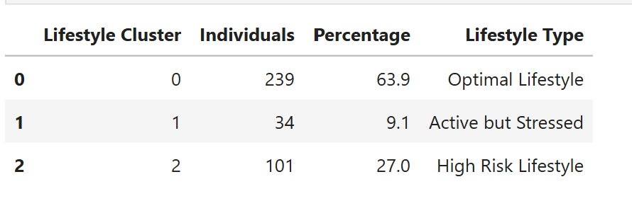
LIFESTYLE SEGMENTATION USING K-MEANS
Why K-Means Clustering ?
Unsupervised Machine Learning Algorithm
Used to identify hidden lifestyle patterns
Groups individuals with similar health and lifestyle characteristics
Helps create meaningful lifestyle segments
Features Used:
Sleep Duration
Quality of Sleep
Physical Activity Level
Stress Level
Heart Rate
Daily Steps

Slide 9
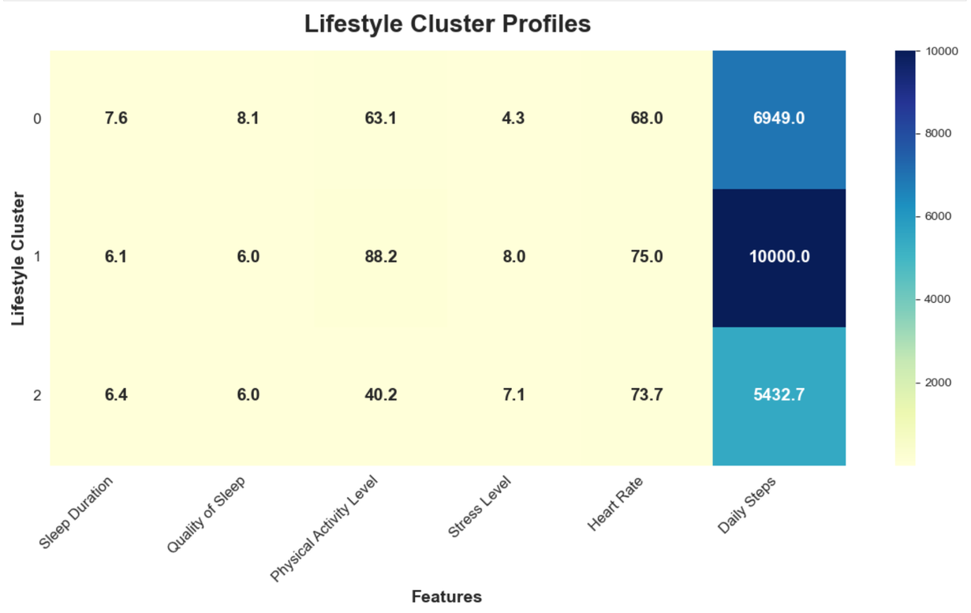
LIFESTYLE CLUSTER PROFILES
Optimal Lifestyle: 239 Individuals (63.9%)
✔ Good Sleep Quality
✔ Healthy Activity Level
✔ Low Stress
✔ Balanced Lifestyle
Key Insights:
Majority have an Optimal Lifestyle.
High Stress is linked to unhealthy lifestyles.
Sleep and Activity drive lifestyle patterns.
Active but Stressed: 34 Individuals (9.1%)
✔ Active Lifestyle
✔ Good Daily Steps
❌ High Stress Despite High Activity
High Risk Lifestyle: 101 Individuals (27.0%)
❌ Poor Sleep Quality
❌ Low Physical Activity
❌ High Stress Level
❌ Unhealthy Lifestyle

Slide 10
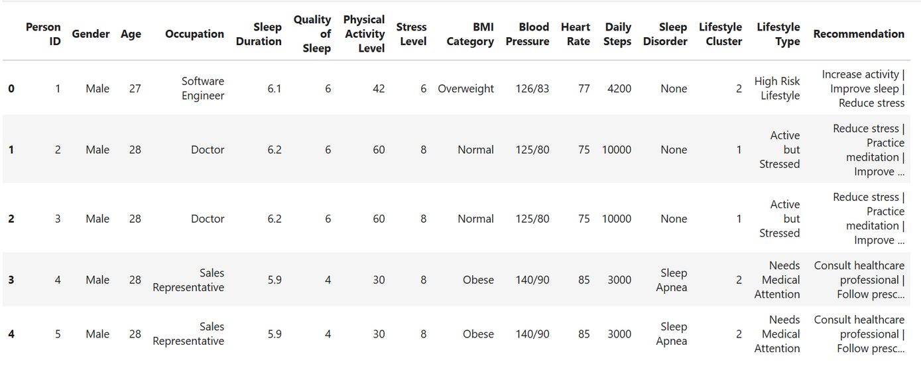
PERSONALIZED LIFESTYLE RECOMMENDATIONS
🟢 Optimal Lifestyle
Recommendation:
Maintain current sleep habits
Continue regular exercise
Maintain low stress levels
🟡 Active but Stressed
Recommendation:
Reduce stress levels
Practice meditation & relaxation techniques
Improve recovery and sleep quality
🔴 High Risk Lifestyle
Recommendation:
Increase physical activity
Improve sleep duration & quality
Reduce stress through healthy habits
💡Personalized recommendations help individuals movefrom high-risk lifestyles toward healthier habits.

Slide 11
CONCLUSIONS & FUTURE SCOPE
Key Findings
Sleep Quality has the strongest relationship with Stress Level (r = -0.899)
Longer Sleep Duration is associated with lower Stress (r = -0.811)
Physical Activity positively impacts Sleep Quality
Occupation significantly affects Sleep Quality (ANOVA Significant)
BMI Category is significantly associated with Sleep Disorders (Chi-Square Significant)
Future Scope
Develop a real-time Lifestyle Monitoring System
Integrate wearable devices and health trackers
Build personalized AI-based health recommendations
Predict sleep disorders before symptoms become severe
Create a health dashboard for continuous lifestyle

Slide 12
THANK YOU
Better Sleep + Lower Stress + Regular Physical Activity = Healthier Lifestyle & Improved Well-Being

